Slide 1
Page ranking

Slide 2
How does google rank pages?
Google ranks the result pages based on the importance score behind each page.
The importance score of any page will be a nonnegative number.
The calculation of the importance score is based on the links made to that page from other pages.

Slide 3
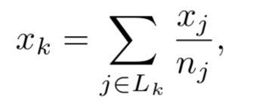
Calculating the Importance Score
The importance score of each page is calculated based on the formula below .
Lk is the index set of pages that links to page k, and nj is the number of links that point from page j to other pages.
Then we put the 1/nj in the (k,j)-entry of the matrix and get a column-stochastic matrix A.
The linear equation for the importance score is Ax = x, where x is the eigenvector corresponding to eigenvalue 1.

Slide 4
Shortcomings
1.Disconnected webs
By using the formula, we cannot always achieve a unique ranking.
Let V1(A) denote the eigenspace of eigenvalue 1. If dim(V1(A)) = 1, then we have only 1 linearly independent solution. If the webs are not connected, dim(V1(A)) will be larger than 1, which means that we will have more than 1 linearly independent solutions.

Slide 5
Shortcomings
2.Dangling Node
The formula does not necessarily result in a column-stochastic matrix.
When a page does not have any link that points to other pages, we have a column that has all zeros in the matrix.
That page is called a Dangling Node.
For the matrix with one or more than one dangling node, its biggest eigenvalue is less or equal to 1.
The matrix is called a substochastic matrix.

Slide 6
A way to overcome the nonunique scores
We let matrix S denote an n x n matrix that all entries in it is 1/n.
Then replace the matrix A (with no dangling node)with matrix M such that M = (1-m)A +mS where 0≤m≤1. Then, M is still a column-stochastic matrix.
The dimension of the eigenspace of M corresponding to eigenvalue 1 is 1 because after adding matrix S, all the entries in M are positive.
Proof. Suppose Mx = x, x is a eigenvector of M, then all entries in M have one sign. For the sake of contradiction, we suppose dim(V1(M)) = 2, which means there are two linearly independent eigenvectors v and w in the subspace V1(M). Then, for any scalar s and t, the vector x = sv +tw must be all positive or negative because x is still an eigenvector. However, since v and w are linearly independent, it is possible to take some values of s and t to make x to have mixed sign. We yield a contradiction. Therefore, dim(V1(M)) = 1.

Slide 7
Computing the importance score
In real cases, there can be billions of pages that match the result.
The easiest way is to compute the score is to use the power method that multiply an initial vector x0 by matrix M many times and normalize. Eventually we can get an eigenvector that corresponding to the biggest eigenvalue.
It is important that initial vector x0 must contain a component of eigenvector of eigenvalue 1. It can be achieved by selecting x0 to have all entries positive.
The power method is calculated by M^(k)x0/||M^(k)x0|| that converges to the eigenvector corresponding to the biggest eigenvalue(1 for column-stochastic matrix) as k goes to infinity.

Slide 8
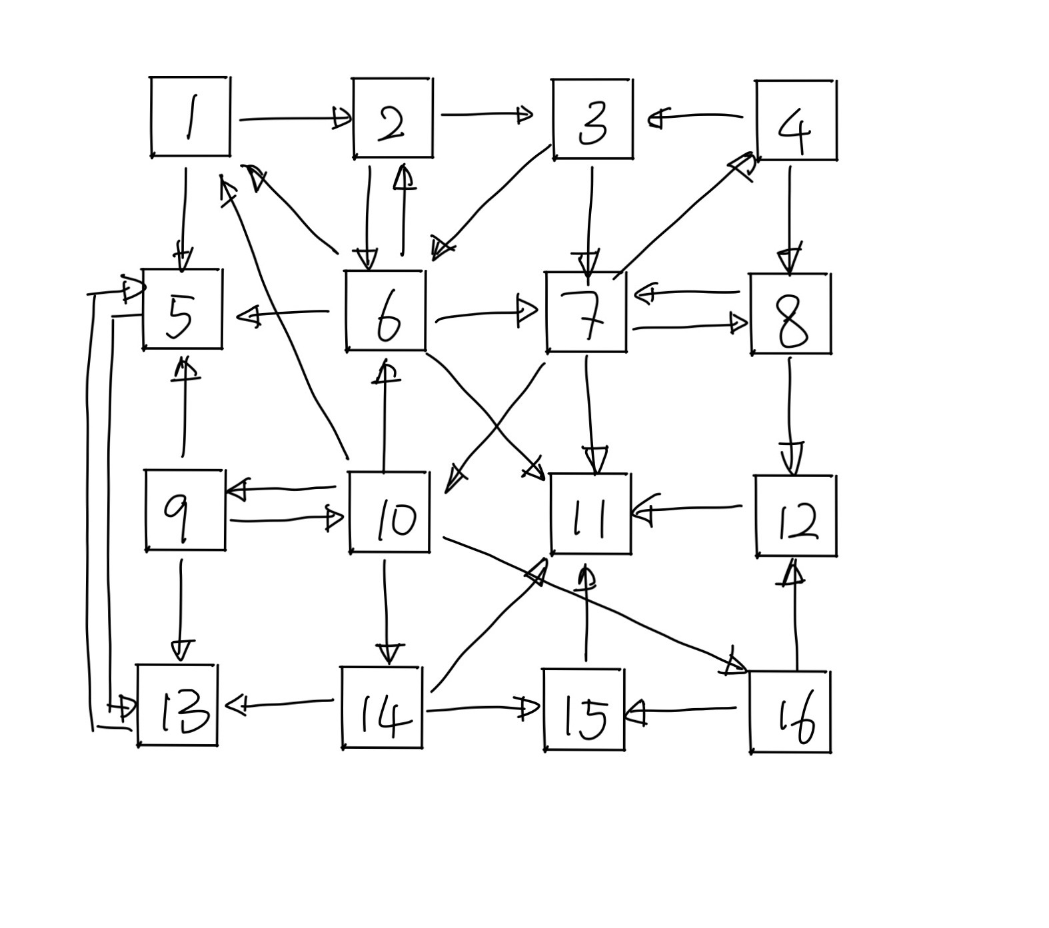
An example of webs
—A 16 by 16 matrix
Now we have a web of 16 pages.
We can easily see that page 11 is a dangling node because it does not have any link that points to other pages.
Therefore, we can achieve a substochastic matrix.

Slide 9
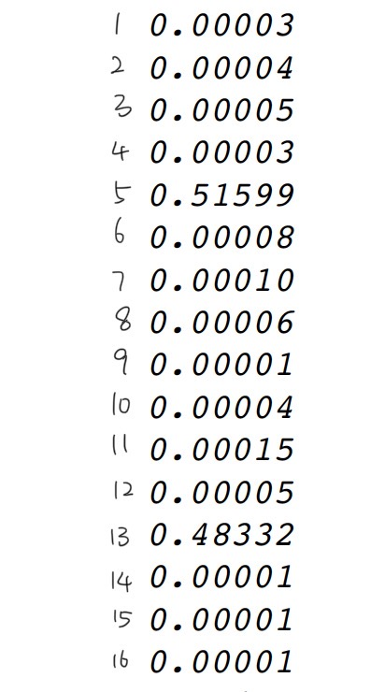
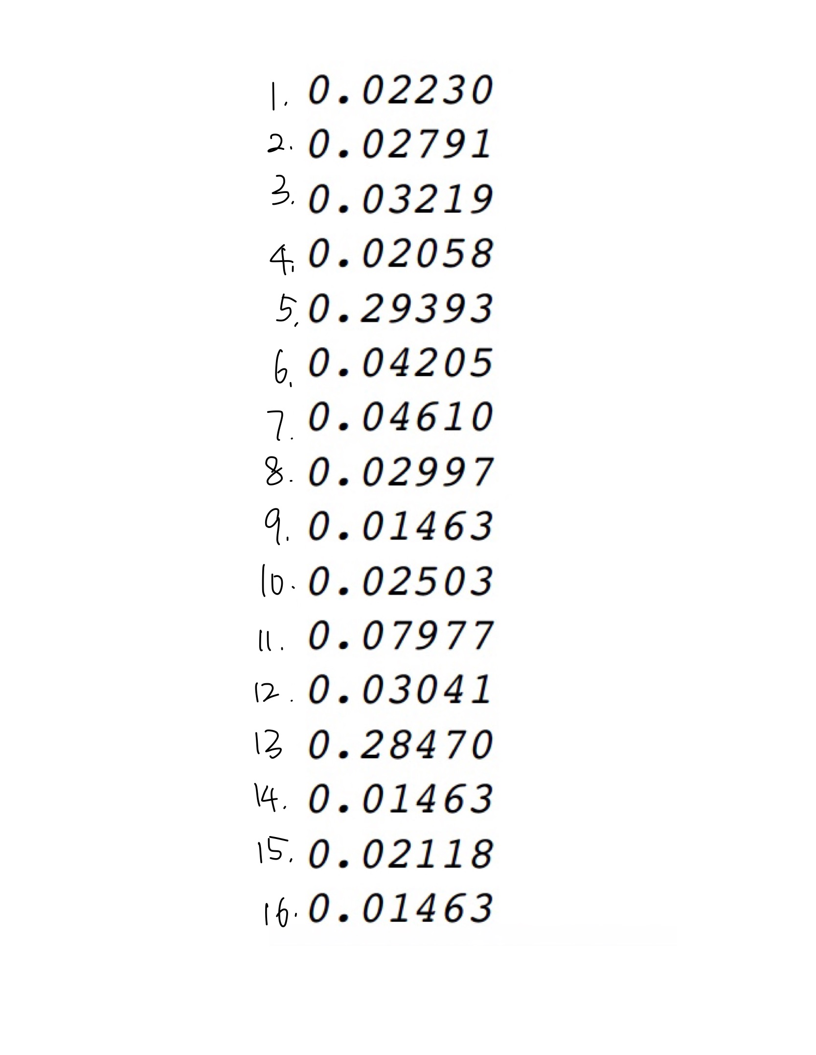
By using the power method,
we calculate the eigenvector when m = 0 and m = 0.15
m = 0
m = 0.15

Slide 10
We see that adding the S matrix(when m is not 0) let pages share their score to each other. Thus, the values in the eigenvector become closer to each other. However, it will not affect the rank of pages.
Page 5 always has the highest score, and page 13 has the second highest score
m = 0
m = 0.15

Slide 11
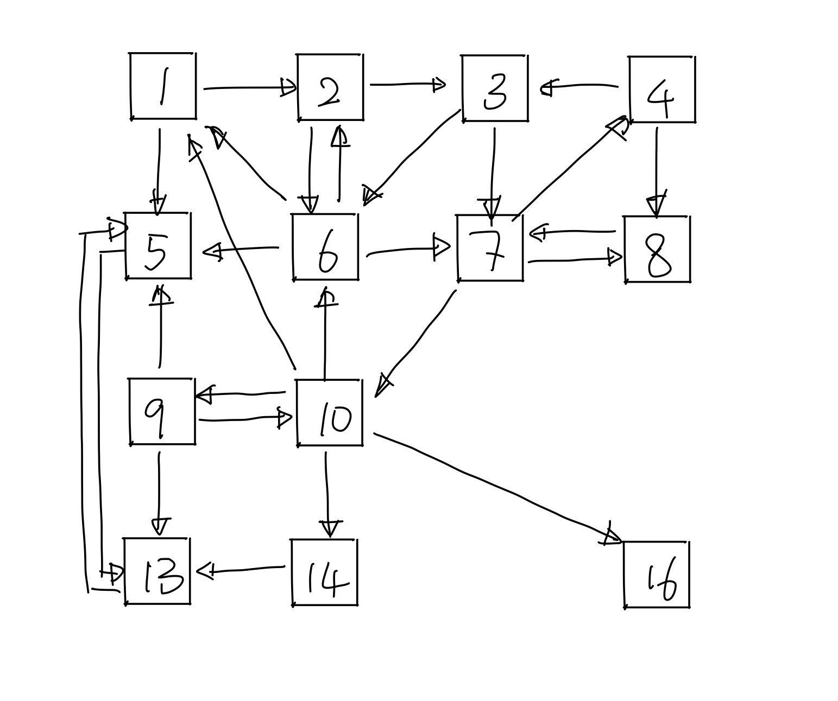
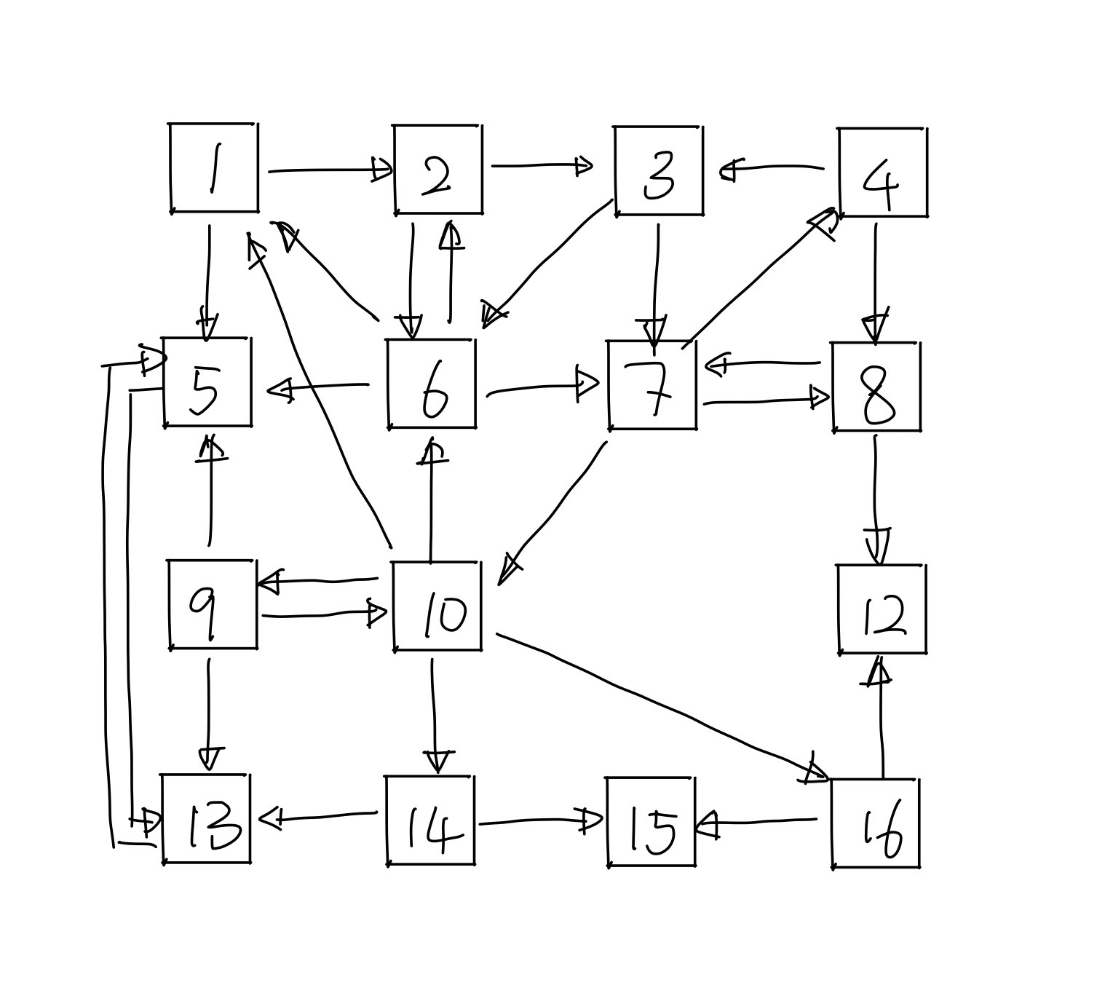
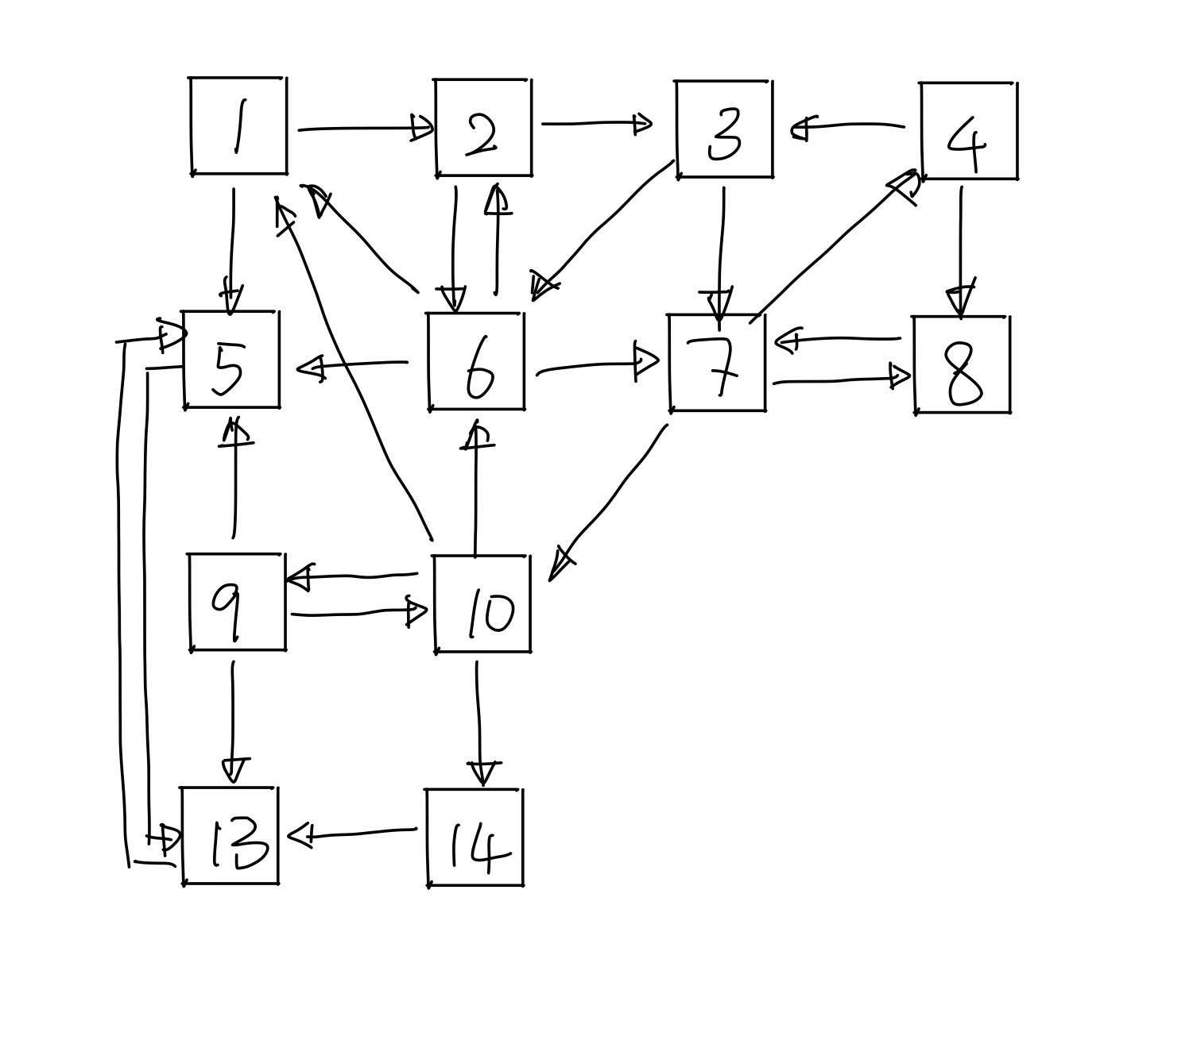
Deleting dangling node
To see whether the page rank with a dangling node make sense, we can delete page 11.
Then page 12 and 15 become dangling nodes.
Continue deleting page 12 page 15. We get page 16 is also a dangling node.
After deleting 4 pages, we get a 12 by 12 matrix.

Slide 12
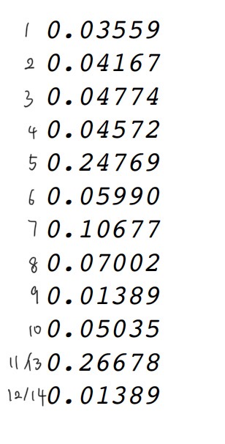
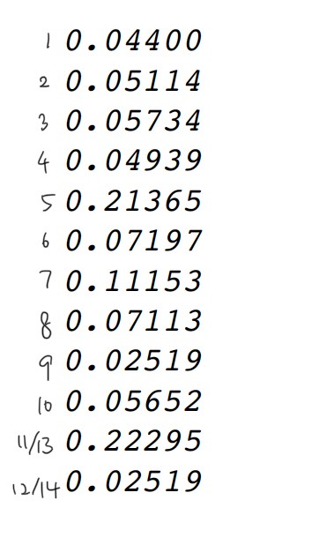
Again, we calculate the biggest eigenvalue and eigenvector of matrix M when m = 0 and m = 0.15
m = 0
m = 0.15
We can see that page 5 and page 13 still have most of the scores, so the rank of the 16 by 16 matrix make sense.
However page 13 now has the highest score.

Slide 13
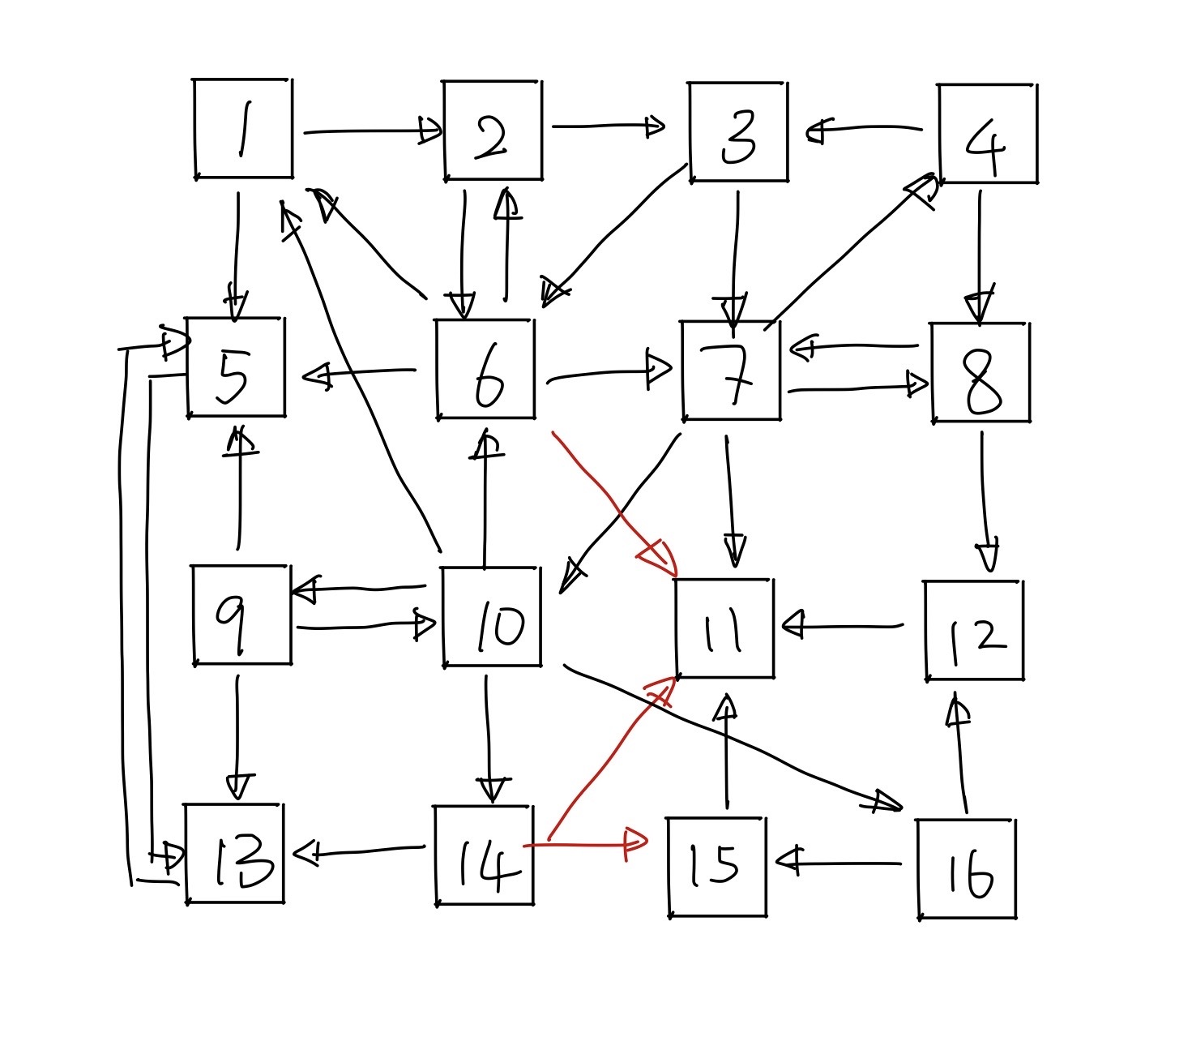
Since page 13 has page 14 that points to it with two links pointing to the dangling nodes, after deleting the dangling nodes, page 14 now share all of its score to page 13.
Page 5 has page 6 that only has one link pointing to the dangling nodes, so page 5 does not receive score as much as page 13.
Therefore, page 13 now ranks higher than page 5.

